Slide 1

Bank Marketing Prediction
Hernan Trujillo
August 2021

Slide 2

01
Introduction

Slide 3

Introduction
The goal of this project is to predict if the client will subscribe a term deposit, based on phone calls of a dataset from a Bank’s marketing team.

Slide 4

Term Deposit Prediction
Data
Kaggle.com
41,188 Observations
20 Features
Client
Financial Institution
Campaign’s Method
Direct marketing (phone calls) to current clients

Slide 5

02
Approach Classification Model

Slide 6

Classification Roadmap
EDA
Visualization
Feature Engineering

Slide 7
Data Details
40+ Observations 20 Features
Conclusions
Processing
Modeling

Slide 8

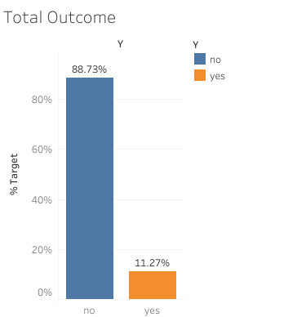
Exploratory Data Analysis (EDA)
Target Variable Distribution:
Imbalanced

Slide 9

Metric Selection:
F1 Score-
Precision: Minimize False Positives
Predicting subscribers when they’re not.
Recall: Minimizes False Negatives
Predicting not subscribers when they will

Slide 10

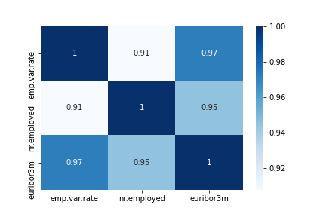
Feature Highly Correlations
Drop 'emp.var.rate' and 'nr.employed' as 'euribor' also give us the price of money in current market.

Slide 11

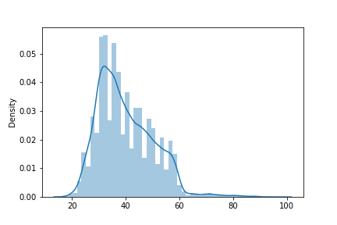
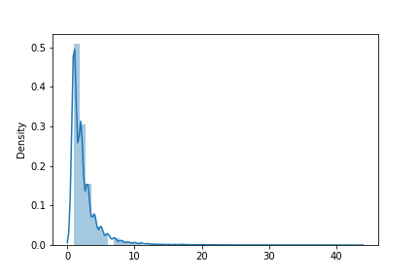
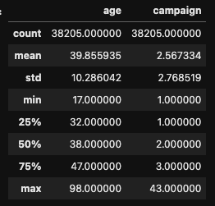
Feature Engineering Outliers
Age
"age" and "campaign" are skewed towards right, we computed the Interquartile Range (IQR) based method and replaced the outliers with the lower and upper boundaries
Campaign

Slide 12
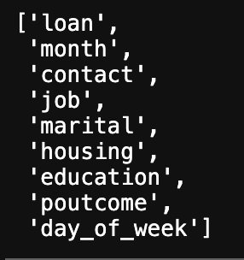
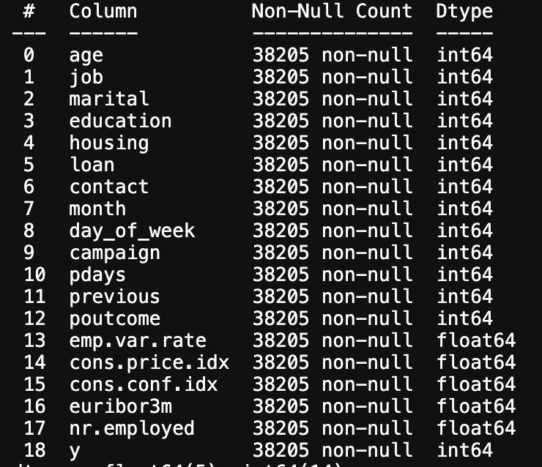
Feature Engineering Encoding Categorical Features

Slide 13
03
Results Modeling

Slide 14

Classification Models Scores
Base Model: Logistic Regression | F1 0.32
Logistic Regression (Class Weight) | F1 0.43 (+34% improved)
Naïve Bayes | F1 0.39
Random Forest | F1 0.40

Slide 15
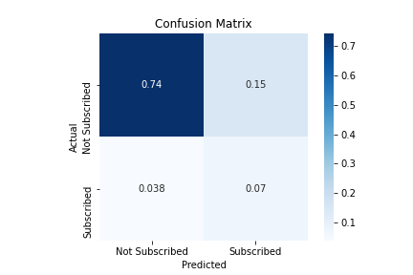
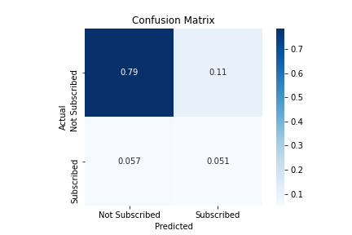
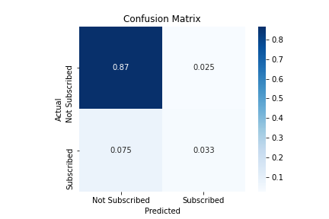
Confusion Matrix
01
02
03
Logistic Regression
Naïve Bayes
Random Forest

Slide 16
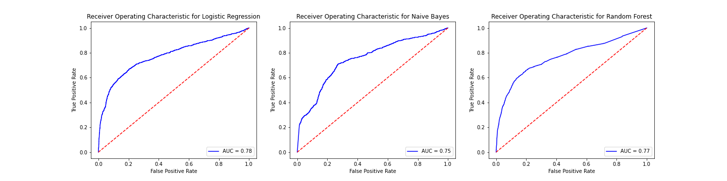
ROC Comparison

Slide 17
F1=0.43
Conclusion:
Logistic Regression Model (Class Weight)

Slide 18

Future work Try more sophisticated models
Model 1
Model 2
XGboost
Gradient Boosting Machines
+ model performance
and computational speed
to decrease the Bias error

Slide 19

Thanks!
hernantru943@gmail.com
GitHub: Hernantru943
LinkedIn: hernantrujillo/

